Slide 1

Innocence vs. Experience
Caitlin Benson, Melissa Roberts, Emily Deering
and Christine Schoenfeld

Slide 2
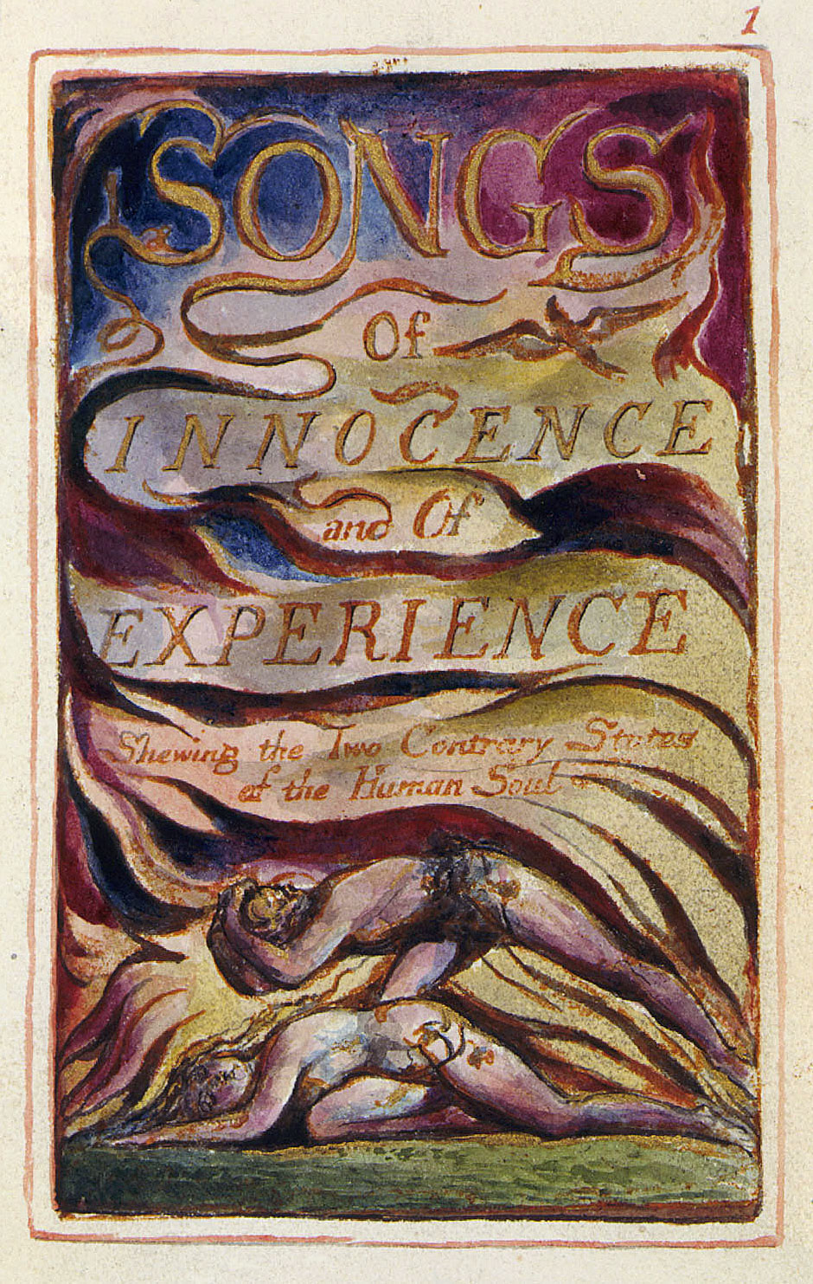
“Showing the Two
Contrary States of the
Human Soul”
Infant Joy
Infant Sorrow

Slide 3
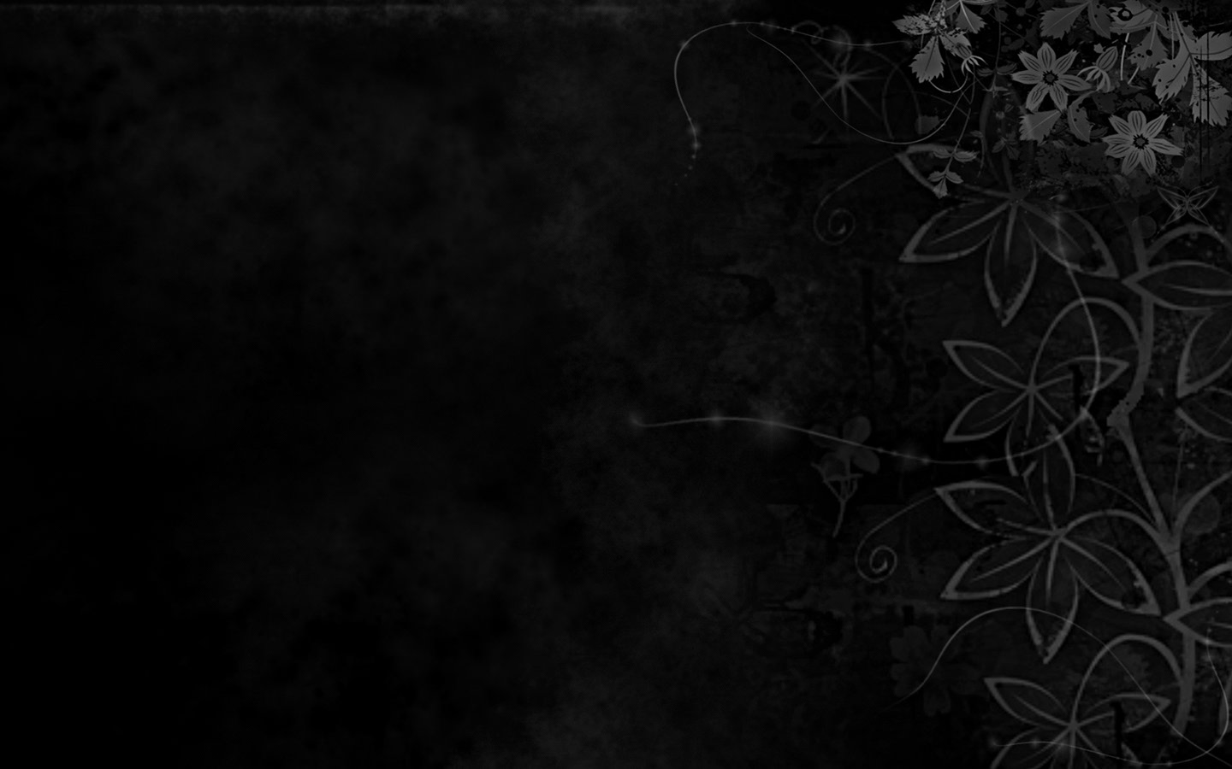
A Modern Spin on Blake
Comparing things that were innocent to us as children, but have hidden corruptions that we finally see as adults.
As children we see things as beautiful. Life experiences corrupt our lives and the way we see things.
“The innocent and beautiful have no enemy but time.”
– William Butler Yeats

Slide 4
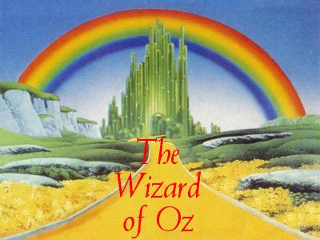
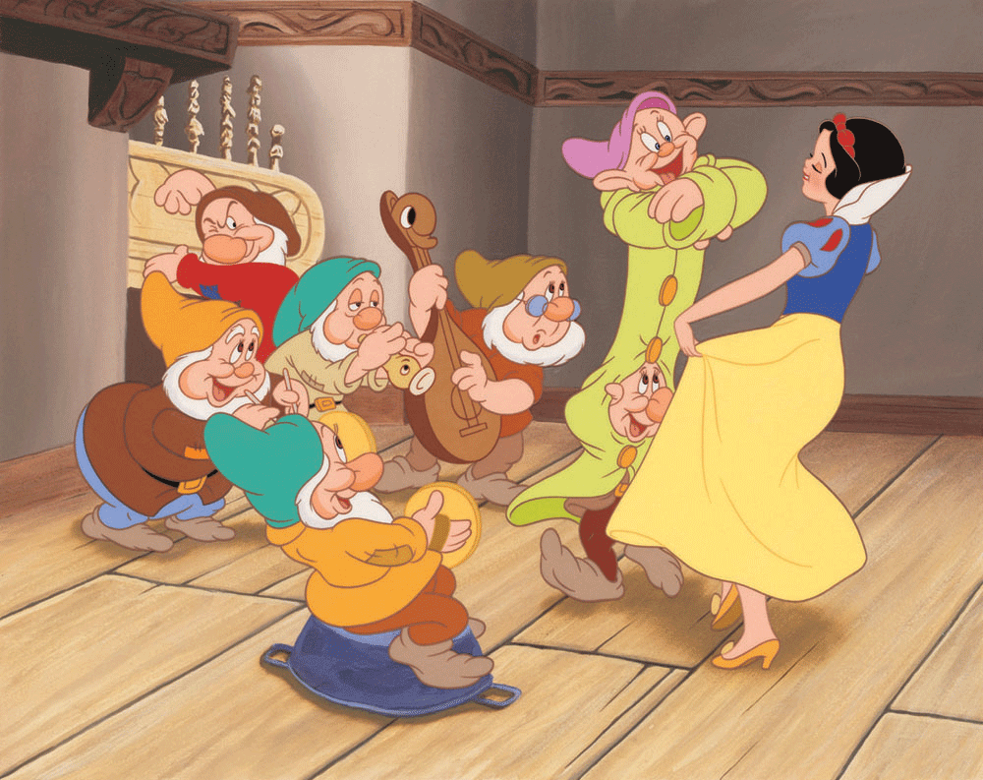
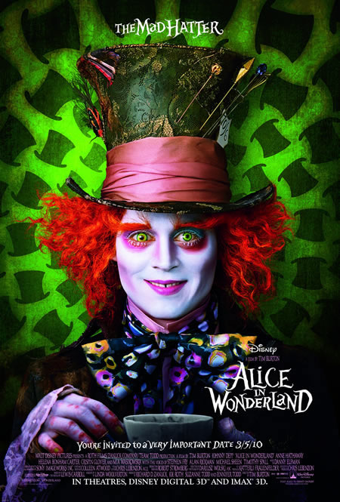
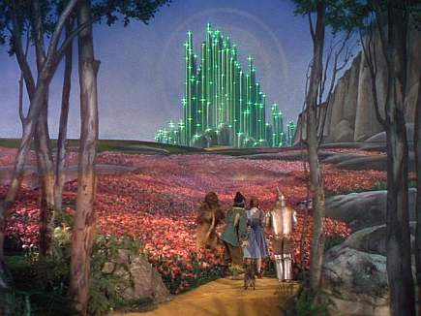
Some of our childhood favorites…

Slide 5
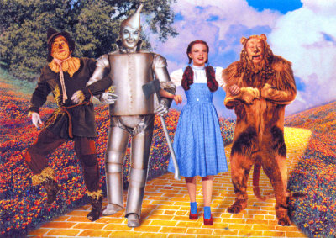

Slide 6

The Wonderful Wizard of Oz
The Wizard of Oz is a classic fantasy movie that came out in 1939
It was based on a 1900 children’s book entitled “The Wonderful Wizard of Oz”
Over the years it has become a favorite of many.

Slide 7

But did you know…
The Wizard of Oz references political issues from the late 1800s and through the Great Depression?
Symbolism can be seen in just about every character and object
Notes:
Harmon, Julie. "Symbolism of the 'Wizard of Oz' | Wicked Tour." Symbolism of the 'Wizard of Oz' | Wicked Tour. Wicked Tour, 7 Sept. 2009. Web. 25 May 2012. <http://wickedtour.net/symbolism-of-the-wizard-of-oz>.

Slide 8
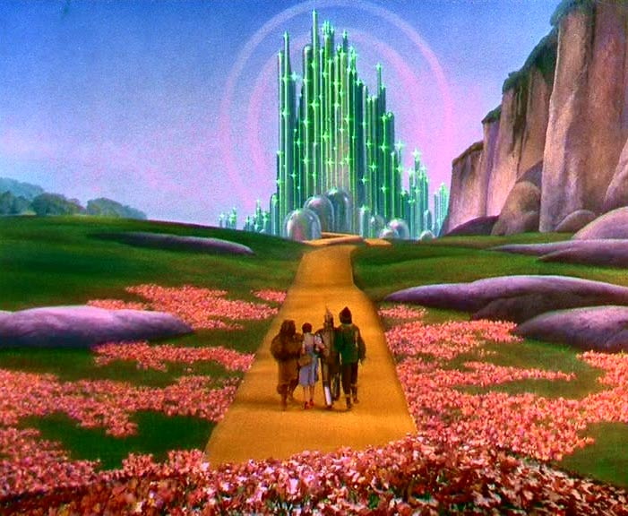
Characters, Objects and Events
Dorothy is thought to represent the American people
Toto is Dorothy’s small dog that represents the average American
The tornado represents political chaos.
The ruby slippers represent monetary issues.
The lollypop guild represents child labor.
The yellow brick road symbolizes the gold standard
The tin man represents industrial workers
The scarecrow represents the farmers
The cowardly lion represents politician William Jennings Brian
Notes:
Harmon, Julie. "Symbolism of the 'Wizard of Oz' | Wicked Tour." Symbolism of the 'Wizard of Oz' | Wicked Tour. Wicked Tour, 7 Sept. 2009. Web. 25 May 2012. <http://wickedtour.net/symbolism-of-the-wizard-of-oz>.

Slide 9
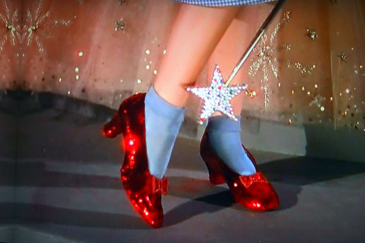
Wicked Witch of the West and East represents businesses in the east, and politician William McKinley.
Good Witch of the South and North represent northern workers, and southern farmers.
Flying monkeys mock political officials
Emerald City represents Washington DC
The Great Wizard himself represents the US President
Next time you watch Wizard of Oz, what will you be thinking about?
Notes:
Harmon, Julie. "Symbolism of the 'Wizard of Oz' | Wicked Tour." Symbolism of the 'Wizard of Oz' | Wicked Tour. Wicked Tour, 7 Sept. 2009. Web. 25 May 2012. <http://wickedtour.net/symbolism-of-the-wizard-of-oz>.

Slide 10
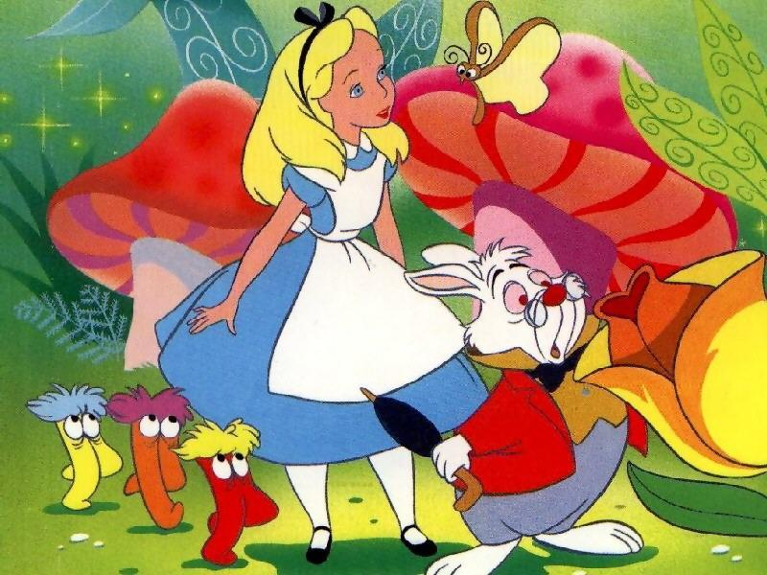
Alice in Wonderland

Slide 11
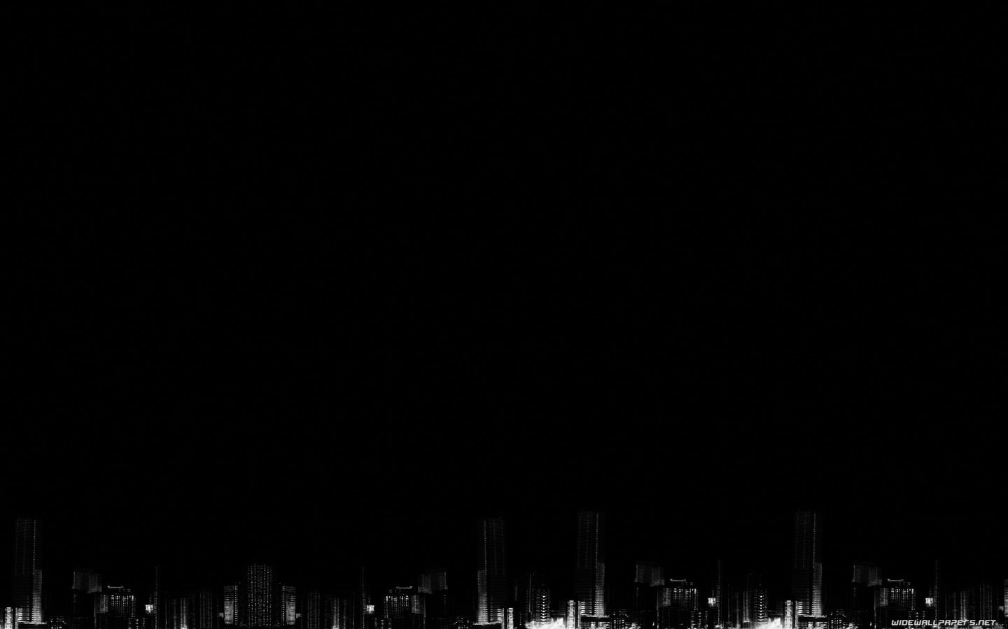
Alice in Wonderland
A 1951 Disney animated film
Based on the book Alice’s Adventures in Wonderland, by Lewis Carroll
Nominated for a Greatest Movie Musical award and 10 Top 10 award by the American Film Institute

Slide 12
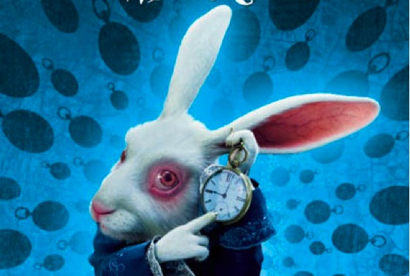
The “Experience” Behind Wonderland
Going “down the rabbit hole” is a general reference to entering a mental state of chaos or confusion
The white rabbit Alice follows is said to signify cocaine or speed. He is white and full of neurotic energy and Alice is chasing him much like an addict.
Notes:
Khalil, Miss. "Drugs in Disney Movies!" HubPages. Hub Pages. Web. 25 May 2012. <http://misskhalil.hubpages.com/hub/Drugs-in-Disney-Movies>.
"Persuasive Critique - Disney's Alice in Wonderland Contains Drug References?" Xomba. 4 July 2008. Web. 25 May 2012. <http://coffincm1972.xomba.com/persuasive_critique_disneys_alice_in_wonderland_contains_drug_references>.

Slide 13
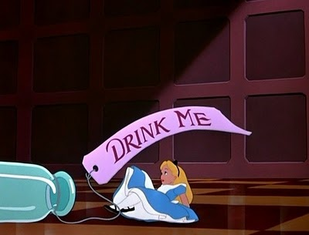
The “drink me” bottle that Alice drinks to change size is said to parallel the space distortion effect of LSD.
The fact that Alice’s size continues to change throughout the movie indicates that she is tripping the whole time.
Notes:
Khalil, Miss. "Drugs in Disney Movies!" HubPages. Hub Pages. Web. 25 May 2012. <http://misskhalil.hubpages.com/hub/Drugs-in-Disney-Movies>.
"Persuasive Critique - Disney's Alice in Wonderland Contains Drug References?" Xomba. 4 July 2008. Web. 25 May 2012. <http://coffincm1972.xomba.com/persuasive_critique_disneys_alice_in_wonderland_contains_drug_references>.

Slide 14
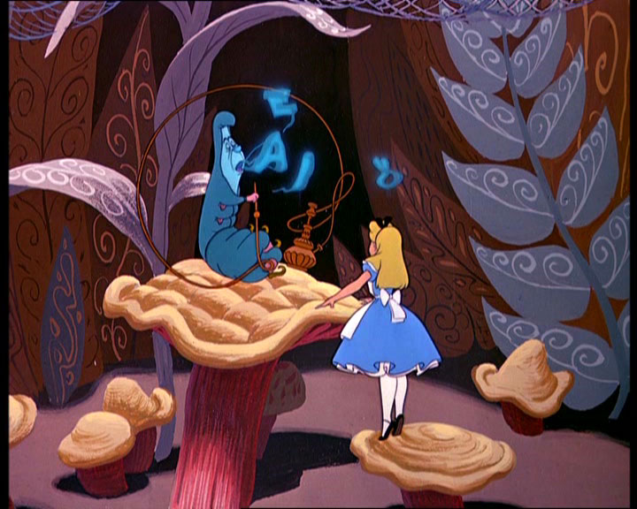
The caterpillar is smoking from a hookah while sitting on a mushroom, implying he may actually be smoking opium or marijuana.
The caterpillar gives Alice some of his magic mushroom when she needs to grow taller.
Notes:
Khalil, Miss. "Drugs in Disney Movies!" HubPages. Hub Pages. Web. 25 May 2012. <http://misskhalil.hubpages.com/hub/Drugs-in-Disney-Movies>.
"Persuasive Critique - Disney's Alice in Wonderland Contains Drug References?" Xomba. 4 July 2008. Web. 25 May 2012. <http://coffincm1972.xomba.com/persuasive_critique_disneys_alice_in_wonderland_contains_drug_references>.

Slide 15
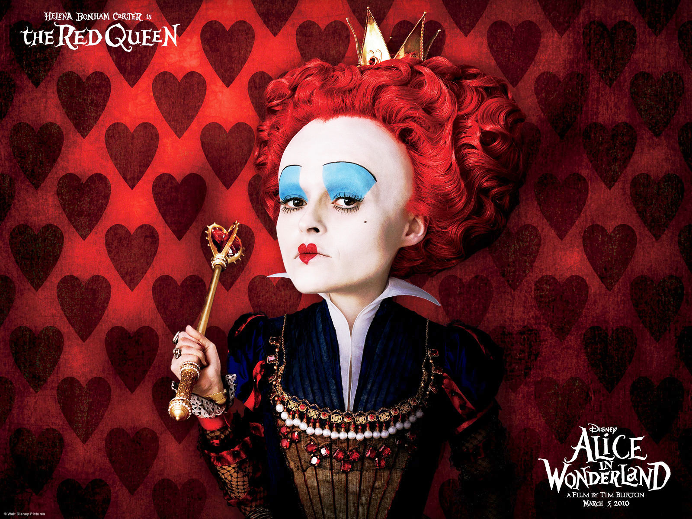
http://youtu.be/KVzyGQPgVN8?t=3m40s
http://youtu.be/X1B6lMJwj44?t=1m4s

Slide 16
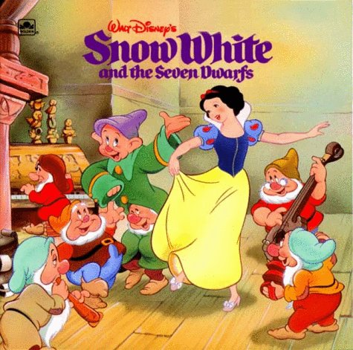

Slide 17
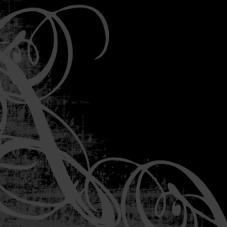
Snow White and the Seven Dwarfs:
A 1937 Walt Disney animated film
Based on a German fairy tale by the Brothers Grimm
Named the greatest American animated film of all time by the American Film Institute 1998
Snow White is known as the fairest and most innocent of them all

Slide 18
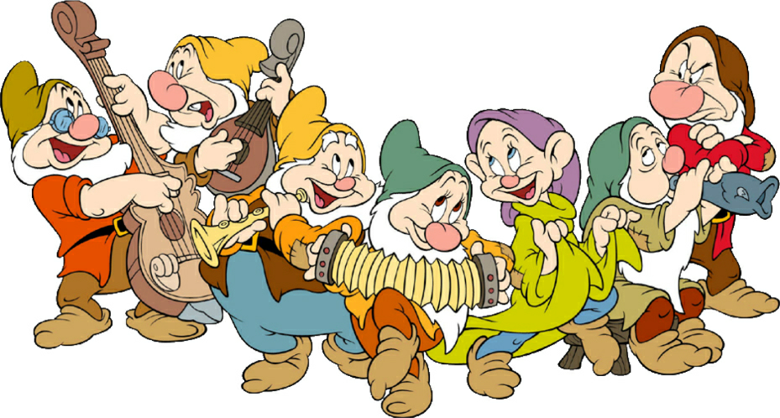
But Have You Considered:
“Snow White” is another name for Cocaine
Cocaine causes exhaustion (Sleepy), mood swings (Happy, Grumpy), allergies (Sneezy) and alteration of personality (Bashful, Dopey) eventually resulting in a trip to the doctor (Doc)
Notes:
Khalil, Miss. "Drugs in Disney Movies!" HubPages. Hub Pages. Web. 25 May 2012. <http://misskhalil.hubpages.com/hub/Drugs-in-Disney-Movies>.

Slide 19
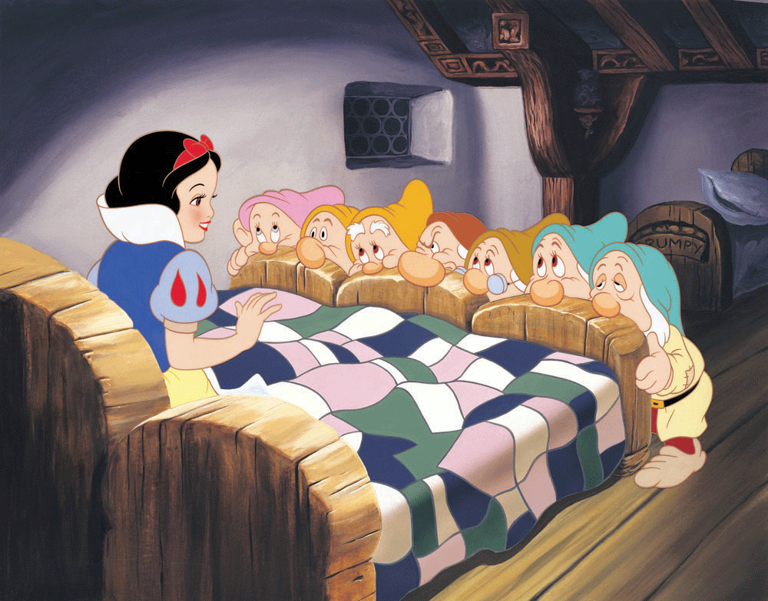
http://youtu.be/vswJS-EVIh4?t=6m18s

Slide 20
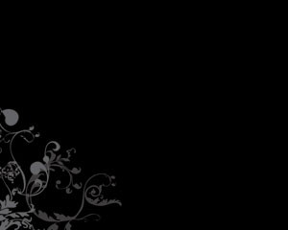
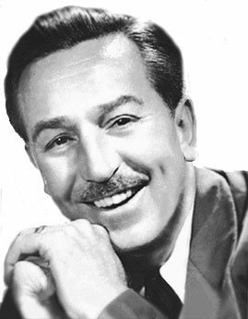
And Did You Know:
One construction worker at Disney quit because he and his coworkers believed that Walt Disney was addicted to cocaine, but no one else would leave with him and sacrifice their job.
Notes:
Khalil, Miss. "Drugs in Disney Movies!" HubPages. Hub Pages. Web. 25 May 2012. <http://misskhalil.hubpages.com/hub/Drugs-in-Disney-Movies>.

Slide 21
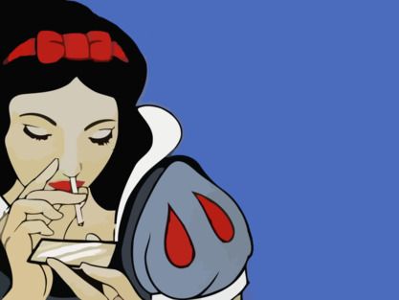
The Nurse’s Song
When the voices of children are heard on the green
And laughing is heard on the hill,
My heart is at rest within my breast
And everything else is still.
Versus…
When the voices of children are heard on the green
And whisp'rings are in the dale,
The days of my youth rise fresh in my mind,
My face turns green and pale.

Slide 22
Mock on, Mock on Marvel, Pixar
We’ll see who’s laughing in the end
After all, Disney’s the one with
$7.4 billion to spend

Slide 23
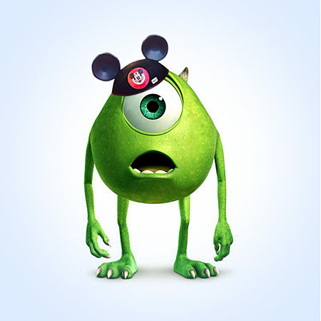
The End

